Slide 1
Human Safety and Response Preparedness
John R. Allen, PhD
NASA Headquarters
Space Operations Mission Directorate

Slide 2
NASA Is Concerned With Two Main Types Of Radiation Risk:
Short-term consequences of relatively high levels of radiation,
  Caused by a Solar Particle Event (SPE),
  Repeated exposure during passage of the South Atlantic Anomaly
  Radiation risk is mainly due to cell depletion of sensitive tissues:
    bone marrow,
    intestinal epithelium,
    skin, etc.
  May lead to conditions affecting crew health and performance
Long-term exposure to expected levels of solar and galactic cosmic radiation
  Enhanced probability of cancer
  Possibly changes in the cells of the brain, reproductive organs, other tissues.

Slide 3
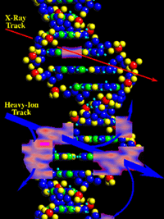
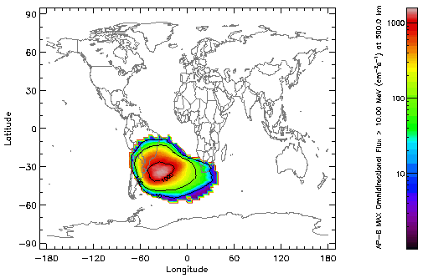
South Atlantic Anomaly
Double Strand Breaks

Slide 4
Basis of a Radiation Protection Program
Principles of Radiation Protection:
  Define risks
  Define acceptable levels, leading to exposure limits
  Justify activity involving radiation exposures in terms of benefits to society
  As Low As Reasonably Achievable (ALARA) requirement
Implementation
  Establish risk projection methods and limits
  Train workers and specialists
  Dosimetry
  Maintaining records
  ALARA documentation

Slide 5
ALARA
The population involved in space activities is of limited size; thus, genetic effects would not play a role.
The benefit of space flight exceeds substantially the risk.
Radiation hazards analysis conducted before each mission.
Radiation exposure monitored by individual/area dosimeters
Records of radiation exposures maintained (including those from medical procedures).
Formal protocols, including the use of calibrated active and passive measurement radiation systems,
Flight rules covering any radiation exposure contingency have been developed and documented.

Slide 6
Radiation Protection Standards
Ground-based Regulations Inappropriate
Permissible Exposure Levels (PELs) - NASA Space Flight Human System Standard – Volume 1 Crew Health
Reviewed by National Council on Radiation Protection and Measurements (NCRP Reports No. 132, No. 137, No. 142)
Space Permissible Exposure Limits
  “…primary functions of preventing in-flight risks that jeopardize mission success and limiting chronic risks to acceptable levels based on legal, ethical or moral, and financial considerations.”

Slide 7
Mitigation of Risk
Use of countermeasures
Five approaches of which only the first two are currently practical
  Operational
  Shielding
  Screening
  Prevention
  Intervention

Slide 8
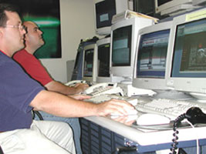
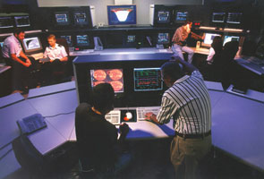
Operational Countermeasures
Limitation of exposure and resultant risk through:
  Projection of mission radiation exposure and risk
    Space Radiation Analysis Group
    Radiation Health Office
  Selection of older crew members
  Avoiding EVAs during passage through the SAA
  Using spacecraft transfer trajectories that minimize the duration of interplanetary travel

Slide 9
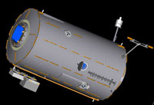
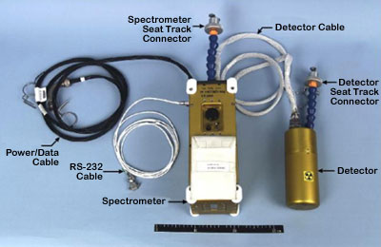

Shielding Countermeasures
Earth’s magnetic field is protective in LEO
Estimates of GCR within 15%
Shielding materials have been tested on ISS
Computational tools have been developed to estimate interaction of radiation with materials
  Standard approach for estimating shielding for spacecraft
Computational models validated with dosimetry
  Personnel dosimetry worn by crew
  Detectors mounted internal and external to the spacecraft
CAD Model of US Lab
Radiation Area Monitor & ISS Tissue Equivalent Proportional Counter

Slide 10
Other Countermeasures
Screening: Potential methods to screen for a genetic predisposition that results in an increased susceptibility or resistance to radiation
Prevention: Development of pharmaceuticals that can be used as radioprotectants and genetic methods to enhance an organism’s ability to repair damage
Intervention: Interventions may be required to address acute radiation effects resulting from solar particle events. Biological interventions such as gene therapy methods to enhance cell repair or apotosis may be possible in the future.

Slide 11
Missions Beyond Low Earth Orbit
Significant risk to crew and mission from space radiation
  No geomagnetic protection
  Space weather events
  Mission durations
  ~x10 compared to ISS
Determination of an acceptable level of risk for exploration underway
NASA has chartered reviews by the NCRP
  NCRP 153 - Information Needed to Make Radiation Protection Recommendations for Space Missions Beyond Low-Earth Orbit
  SC 1-13: Impact of Individual Susceptibility and Previous Radiation Exposure on Radiation Risk for Astronauts
  SC 1-15: Radiation Protection and Science Goals for Short-Term Lunar Missions

Slide 12
Information Needed as published in NCRP 153
Space Radiation Environment
  Develop SPE forecasting and prediction capabilities
  Develop realistic models of the largest expected SPE fluence rates
  Continue to improve the GCR environmental models used for risk assessment
Space Radiation Physics and Transport
  Develop and validate space radiation transport codes
  Improve existing nuclear interaction databases

Slide 13
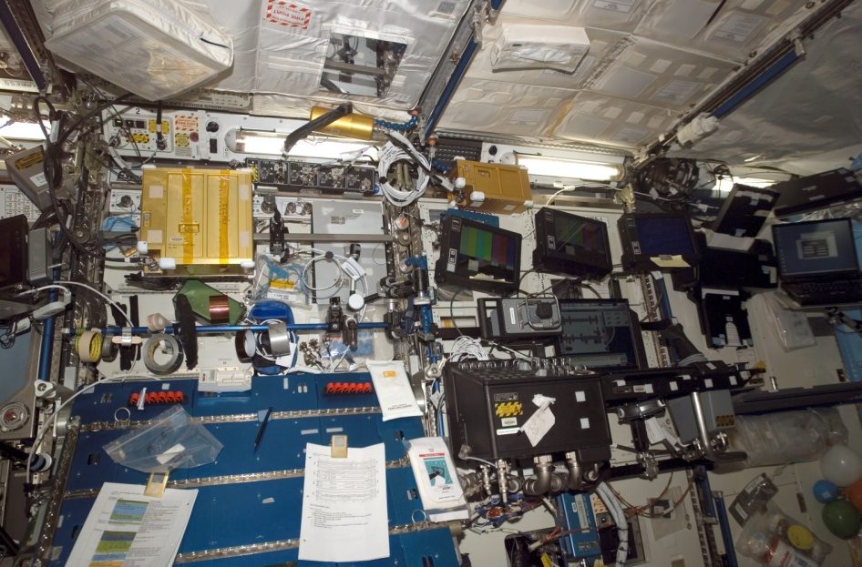
Information Needed (Cont.)
Space Dosimetry
  Develop, certify and fly reliable rugged monitoring equipment
  Improve neutron spectrometers
  Validation of transport and dosimetry models
  Improved understanding of Tissue Equivalent Proportional Counter (TEPC) response
    Measures radiation dose and dose equivalent in fields containing a mixture of particle types
  Improved organ dose assessment
TEPC

Slide 14
Information Needed (Cont.)
Space Radiation Biology
  Late radiation effects (cancer/non-cancer)
  Early radiation effects
    Thresholds for neurovestibular, cardiac, prodromal and other CNS efffects
    Hematological, dermal and immune issues
  Dose rate effects
  Countermeasure development
Goal: Improved Risk Assessment Model → Acceptable Level of Risk

Slide 15
Designing Vehicles with Current Knowledge
Communicating importance of radiation protection
  Radiation System – part of Vehicle Integration Office – Spacecraft Design
Allocation of PELs to vehicle design
Human System Integration Standards
Currently a “work in progress”
Flexibility in the future will be required

Slide 16
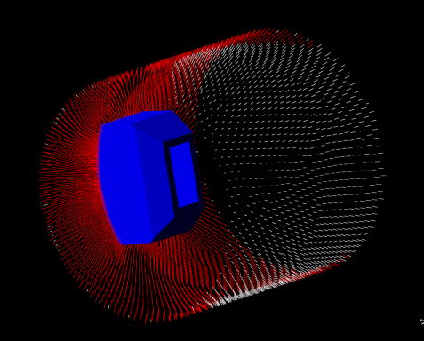
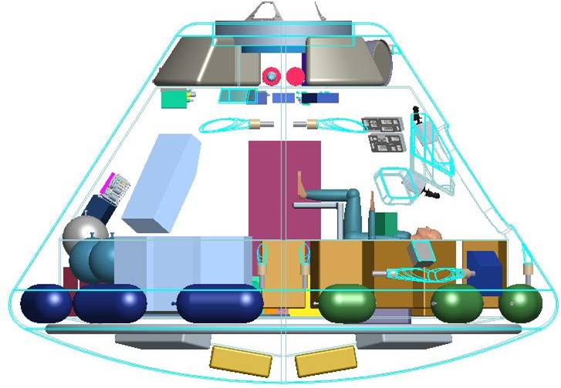
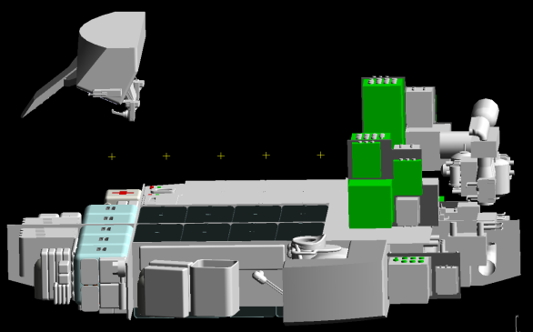
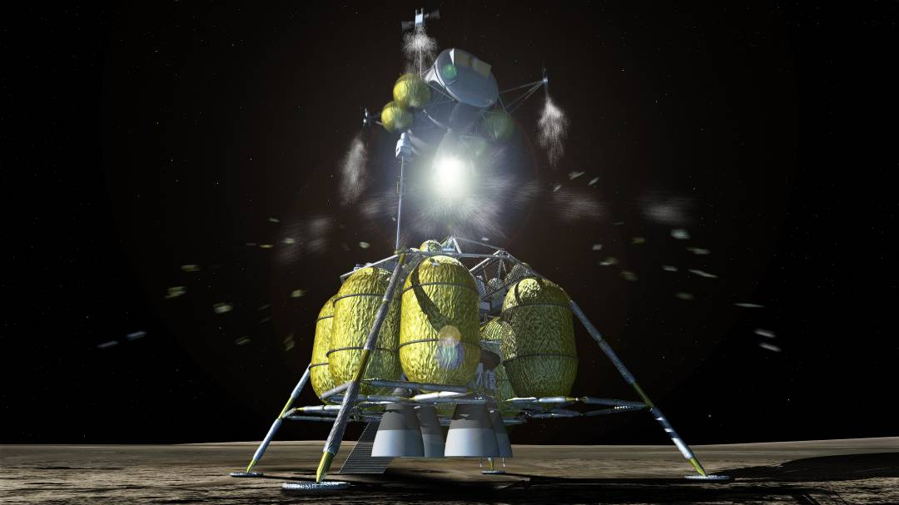
Design and Response Operations
The best opportunity for implementing ALARA inside vehicles and habitats is during the design process
Mass/volume penalty
  GCR difficult if not impossible to shield
Design
  Use of physics codes to model vehicle
  Multi-use materials and geometry optimization
  Radiation protection as design element
  Provide baseline shelter
Operations
  Concept of Operations development ongoing
  Risk minimization
  Mission flexibility
  “Worst Case”
Courtesy of the Space Radiation Analysis Group

Slide 17
Implications for Commercial Ventures
Same concerns and planning as NASA
  Mission length, destination, exposure, shielding, craft design, monitoring, PREDICTION, etc.
Duration and destination may be different – initially
Participants vs Crewmembers
  Frequency of exposure
Commercial Aerospace
  Polar routes

Slide 18
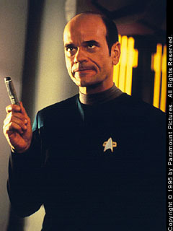
Questions ?

